Slide 1
SQL - SELECT
Key Concepts:
SELECT (Choose columns)
AS (Rename a column)
TOP (T-SQL specific feature; display only the top n – see next slide set for more details)
FROM (Choose table)
WHERE (Condition on rows, applied to each row individually)
GROUP BY (Collapse multiple rows into one group)
HAVING (Condition on groups)
ORDER BY (Display output in a specific order)
Processing order: FROM, WHERE, GROUP BY, HAVING, SELECT, ORDER BY

Slide 2
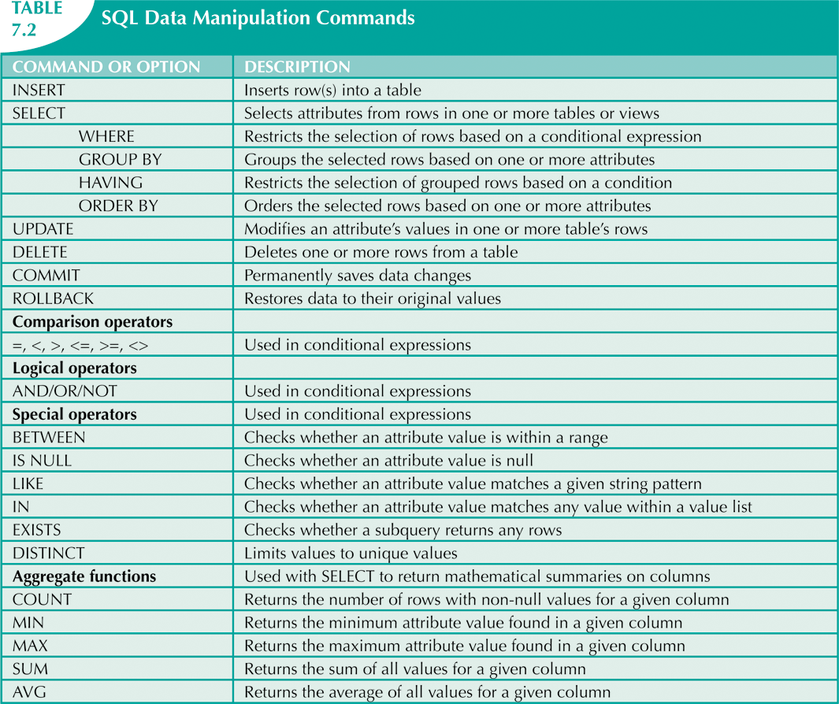
Data Manipulation Language (DML)

Slide 3
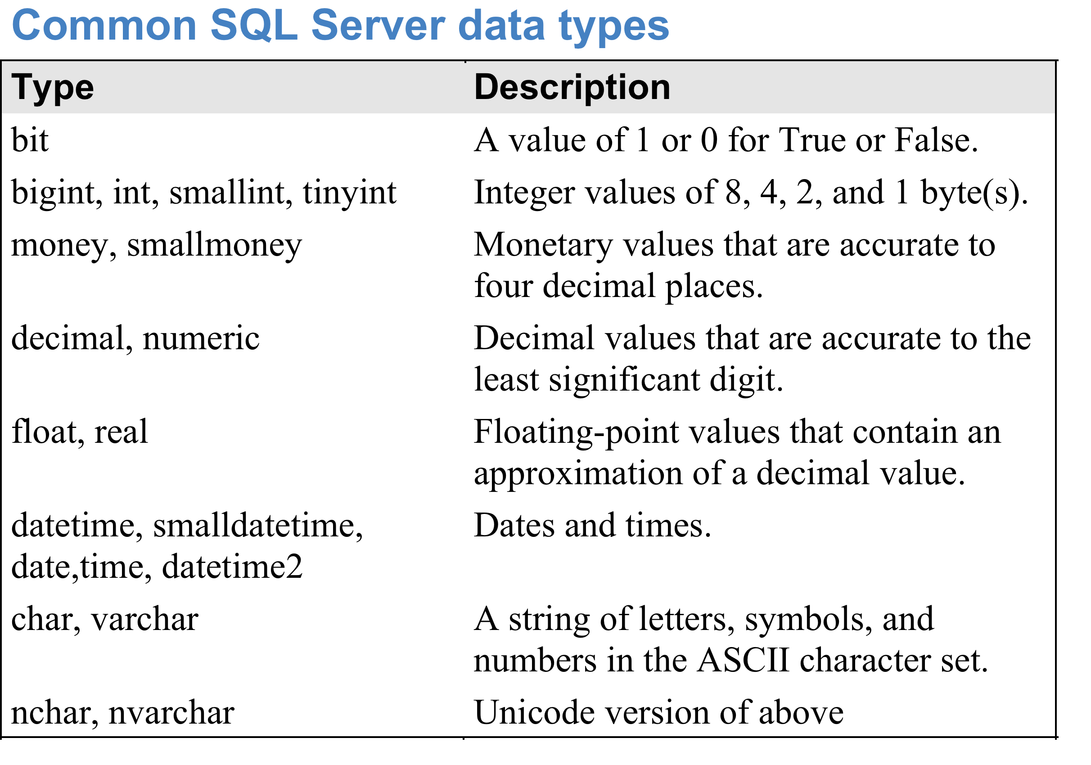
SQL Server Architecture
Schema
Object

Slide 4
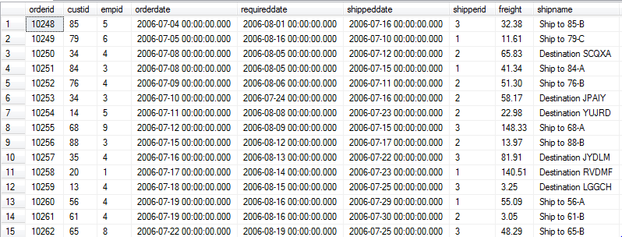
Database Table - Sample
Table Sales.Orders
Not all rows and columns are shown.
There are 830 rows in this table.

Slide 5
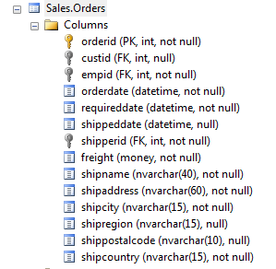
DataTypes in a Table
The data types in any table can be viewed by expanding the “Columns” section.
E.g. for Sales.Orders:

Slide 6
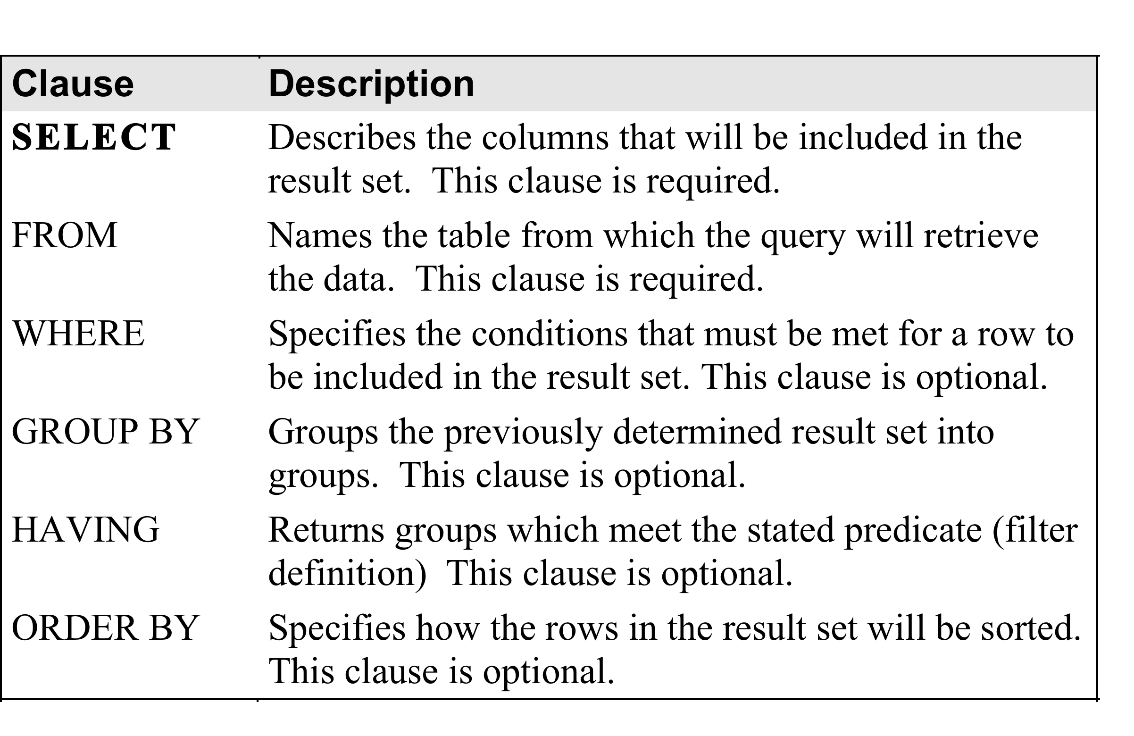
Select Statement
Queries one or more tables, applies some logical manipulations, and returns a result.

Slide 7


SELECT a Literal
SELECT 1; SELECT ‘ABC’;
SELECT can be used by itself to do calculations.
E.g. SELECT 2+2 returns 4.
No data is being extracted from the database in these examples.
Selecting a literal is not very common but can occasionally be useful.

Slide 8
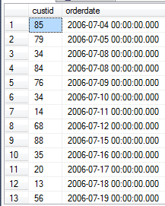
SELECT Example - FROM
(1) SELECT custid, orderdate FROM Sales.Orders;
830 rows total
Order of columns is determined by SELECT statement, not original order.
The order of rows is arbitrary.

Slide 9
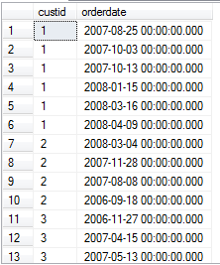
SELECT Example – ORDER BY
(2) SELECT custid, orderdate
FROM Sales.Orders
ORDER BY custid;
830 rows total
Default order is ascending.
NOTE: Since the order of rows is supposed to be irrelevant in the relational model,
the result of a query with ORDER BY is technically not a valid relation.

Slide 10
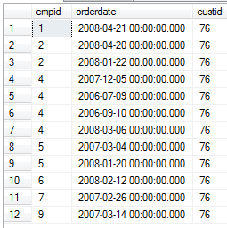
SELECT Example - WHERE
(3) SELECT empid, orderdate, custid
FROM Sales.Orders
WHERE custid = 76
ORDER BY empid;
12 rows total
Note that within each empid, the orderdates are NOT ordered.

Slide 11
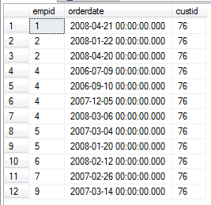
SELECT – ORDER BY Multiple Columns
(4) SELECT empid, orderdate, custid
FROM Sales.Orders
WHERE custid = 76
ORDER BY empid, orderdate;
12 rows total
Now the orderdates ARE ordered within each empid.

Slide 12
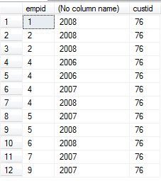
SELECT – Apply Functions to Columns
(5) SELECT empid, YEAR(orderdate), custid
FROM Sales.Orders
WHERE custid = 76
ORDER BY empid, orderdate;
YEAR(date) is a function that returns only the year part of a date field.
Notice the column has no name!
Note also some duplicate rows – not a valid relation.

Slide 13
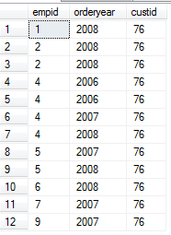
SELECT – AS names a column
(6) SELECT empid, YEAR(orderdate) AS orderyear, custid
FROM Sales.Orders
WHERE custid = 76
ORDER BY empid, orderdate;
AS gives a name,
called an alias,
to the column.
NOTE: AS is optional,
but should be included.
12 rows total

Slide 14
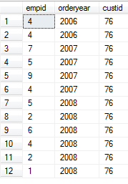
SELECT Example – No ORDER BY
(7) SELECT empid, YEAR(orderdate) AS orderyear, custid
FROM Sales.Orders
WHERE custid = 76;
-- Comment: Removed the ORDER BY
12 rows total

Slide 15
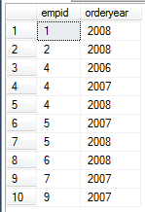
SELECT Example – GROUP BY
(8) SELECT empid, YEAR(orderdate) AS orderyear
FROM Sales.Orders
WHERE custid = 76
GROUP BY empid, YEAR(orderdate);
NOTE: CANNOT put orderyear here.
Note that the 2 "4 2006" rows
have been placed in 1 group,
as have the 2 "2 2008" rows.
10 rows total

Slide 16

SELECT Example - HAVING
(9) SELECT empid, YEAR(orderdate) AS orderyear
FROM Sales.Orders
WHERE custid = 76
GROUP BY empid, YEAR(orderdate)
HAVING COUNT(*) > 1;
HAVING finds groups having a certain property.
WHERE finds rows having a certain property.
COUNT(column) returns the number of non-null elements in column. COUNT(*) returns the number of non-null rows in each group.
2 rows total

Slide 17

SELECT Example – GROUP BY & ORDER BY
(10) SELECT empid, YEAR(orderdate) AS orderyear
FROM Sales.Orders
WHERE custid = 76
GROUP BY empid, YEAR(orderdate)
HAVING COUNT(*) > 1
ORDER BY empid;
2 rows total
GROUP BY represents each group by a single row.
Then ORDER BY can be used to order the groups.

Slide 18

SELECT – Use Function to Make New Column
(11) SELECT empid, YEAR(orderdate) AS orderyear, COUNT(*) as NumOfOrders
FROM Sales.Orders
WHERE custid = 76
GROUP BY empid, YEAR(orderdate)
HAVING COUNT(*) > 1
ORDER BY empid;

Slide 19

ORDER BY with DESC
(12) SELECT empid, YEAR(orderdate) AS orderyear, COUNT(*) as NumOfOrders
FROM Sales.Orders
WHERE custid = 76
GROUP BY empid, YEAR(orderdate)
HAVING COUNT(*) > 1
ORDER BY empid DESC;

Slide 20
Actual Order of Execution
FROM: The query is performed on the specified table.
In this example the table is Orders in the Sales schema.
WHERE: Filters the query so that only rows satisfying the condition are returned.
In this example only rows with customer ID = 76 are returned.
GROUP BY: Groups the results using the specified attribute(s).
In this example a group is formed for each unique combination of employee ID and order year.
HAVING: Returns groups (not rows!) that satisfy the condition.
In this example the number of occurrences must be > 1.
SELECT: Specifies the attributes to be returned.
In this example the employee ids, order year, and count for each group.
ORDER BY: Orders the returned groups using the specified attribute(s).
ASC [ascending] is the default, DESC can be stated.
NOTE: It is allowed to ORDER BY an attribute not in the SELECT list.

Slide 21
FROM Clause
FROM specifies the name of the table(s) you want to query.
In this chapter we concentrate on a single table.
Later we will combine multiple tables in the FROM statement.
Good idea to always specify the schema name explicitly.
SQL Server will try to resolve it if it is missing. Small amount of extra processing and could go to the wrong table.
The simplest query on a table has SELECT and FROM.

Slide 22
WHERE Clause
WHERE defines a predicate used to filter the rows returned by the FROM clause.
Returns only rows where the predicate evaluates to True – not Unknown or False.
True is not the same as (Not False) because of three-valued logic.
NOTE: WHERE filters each row according to the condition. It cannot be used across different rows.
E.g. Find customers whose orders were shipped by shipper 3 but not by shipper 2.
The following does NOT work:
SELECT custid
FROM Sales.Orders
WHERE shipperid = 3 AND shipperid != 2;
Notes:
CHAP2WHERE.sql

Slide 23
GROUP BY Clause
Rather than return one line per row, GROUP BY allows you to return one line per group, where a group is defined by the elements you define in the GROUP BY clause.
A group is formed for each unique combination of the attributes specified.
Example: GROUP BY empid, YEAR(orderdate)
This creates one group for each unique combination of rows with the same empid and order year.
All subsequent clauses (i.e. HAVING, SELECT, and ORDER BY) operate on groups and not on individual rows.
All these clauses must return a single value per group, not per row.
Can use aggregate functions which return a single value per group.
COUNT, SUM, AVG, MIN, and MAX.
Notes:
SQLGROUPBY.sql

Slide 24
HAVING Clause
HAVING specifies a predicate to filter groups (return only groups for which the predicate evaluates to True).
Similar to the WHERE clause, but for groups rather than individual rows.
Returns only rows where the predicate evaluates to True – not Unknown or False.
Can use aggregate functions in the predicate.
E.g. HAVING COUNT(*) > 1
Means the group contains more than one row.

Slide 25
SELECT Clause (Required)
Specify the attributes (columns) that you want returned.
Simplest case – just return attributes without further manipulation.
E.g. SELECT empid
By default, the name of the result attribute will be the same as the original attribute.
The attributes can be manipulated using in-built functions (e.g. YEAR(orderdate)). In this case returned fields do not have a name unless an alias is used.
Columns with no name are allowed by T-SQL, but violate the relational model, so are discouraged!
Notes:
SQLSELECT.sql

Slide 26


Aliasing
AS: Assigns another name (alias) to a result attribute.
E.g. SELECT empid AS employee_id
When manipulating attributes, always use aliasing.
E.g. SELECT YEAR(orderdate) AS orderyear
Note: aliases cannot be used in WHERE, GROUP BY, or HAVING, because they are applied before SELECT.
Also cannot refer to an alias created in the same SELECT statement, even if it is to the left of the expression that attempts to refer to it.
E.g. SELECT Year(X) AS Y, Y+1 AS NextY
SELECT Year(X) AS Y, Year(X)+1 AS NextY

Slide 27
Aliasing
Three syntaxes for applying an alias:
(1) <expression> AS <alias> Recommended
(2) <alias> = <expression>
E.g. year_order = YEAR(orderdate)
(3) <expression> <alias> DEFINITELY AVOID
E.g. YEAR(orderdate) year_order
NOTE: The 3rd form is the reason behind a subtle error.
Leaving out the comma between 2 attributes in a SELECT does NOT produce an error – instead the columns will be aliased!
E.g. Typing SELECT X Y instead of SELECT X, Y does NOT produce an error – instead X will be aliased to Y.
What happens if the alias is the name of another column?

Slide 28
ORDER BY Clause
ORDER BY sorts the rows in the output for presentation purposes.
Tables have no guaranteed order.
ORDER BY guarantees the order, but then the result is technically not a relation.
ORDER BY is executed after SELECT, so you can use aliases.
E.g. ORDER BY empid, orderyear
Can use the number of the column instead of the name.
E.g. ORDER BY 1, 2
Regarded as bad programming practice.
Can include attributes in the ORDER BY clause that do not appear in the SELECT clause (unless SELECT DISTINCT is used – why?)
Can specify ascending (ASC) or descending (DESC) order (ascending is the default). Ties are broken arbitrarily.
Notes:
SQLORDERBY.sql
SQLORDERBYDISTINCT.sql

Slide 29
SELECT *
SELECT *
FROM Sales.Orders;
Is this legal? Yes – it returns all the columns in the order that they were placed in the table.
Is it good programming practice? No.
Suppose some change is made – e.g. a column is deleted or the order changed.
Application programs relying on the result of the query may manifest strange bugs.
Always specify explicitly the columns you want in the order you want.
However SELECT * can be very useful - it shows the entire table and can help figure out how to compute the values you want.

Slide 30
Things to Know about SELECT
The results of SELECT can be either:
(1) NULL
(2) A single element (1 row and 1 column)
(3) A single column (1 column and multiple rows)
(4) A single row (1 row and multiple columns)
(5) A "full" table (multiple rows and multiple columns)
The result of SELECT is NOT a valid table in the relational model if either:
(1) Some columns have no names.
(2) Duplicate rows occur.
(3) ORDER BY is used.
SELECT without a FROM is actually allowed, using constants:
E.g. SELECT 1 AS n
Returns a table with 1 column called n containing one row with a 1 in it.

